Slide 1
CORE JAVA PROJECT
BANK MANAGEMENT SYSTEM
BY,
SHIVANI GOLE

Slide 2
CONTENTS:
Introduction
Main class
Admin Operation
Main Operation
Database connection class
Bank Management process class
Output/Snapshot
Conclusion

Slide 3
INTRODUCTION:
The Bank Account Management System is an application for maintaining a person's account in a bank. In this project I tried to show the working of a banking account system and cover the basic functionality of a Bank Account Management System.
To develop a project for solving financial applications of a customer in banking environment in order to nurture the needs of an end banking user by providing various ways to perform banking tasks.
This project is developed using PHP, HTML language and MYSQL use for database connection. Creating and managing accounts.
A bank is a financial institution which accepts deposits, pays interest on pre-defined rates, clears checks, makes loans, and often acts as an intermediary in financial transactions. It also provides other financial services to its customers.

Slide 4
MAIN CLASS:
In this main class looks like first page of the bank management system can add new customer&new registration & exit the page.
It will give the choice like admin and User registration Process.
If the customer is admin then it gives only login option or the User its customer it will gives new user registration and login options.
After the login admin can perform admin operations and user can perform the new user accounts in bank & total bank balance in bank account operations.

Slide 5
DATA BASE CONNECTION CLASS:
In this class we are connecting the eclipse and mysql software for the operations. We are making the connections to java code and sql query.
For that connection: driver="com.mysql.cj.jdbc.Driver“
Here we are loading the driver in pom.xml file after that it will create the dependency.
url="jdbc:mysql://localhost:3306/airline_reservation_system“
This url gives the path to connect the eclipse with mysql. Host is local host and port number is 3306 is used here. And ater that the project name is given.
After this url the user name and pass word for that local host we need give.
Then the farName method is used for load the drive at the runtime in dynamically.

Slide 6
Admin Process
ADMIN PROCESS:
Admin Login
New User Registration
User Login
User Accounts
Total Accounts & Balance in Bank
Exit.
ADMIN Login: This admin registration operation is performed in the back end process . During this registration customer id, username and password these are the information’s are stored in the database by the backed process.

Slide 7
New User Registration : It can be in the new user registration oprations can be performed in login in new user in new registered user id and add the new customer in bank account and perform some operations.And also this information can be stored in to the database.and new user added successfully in account.
User Login: In this process already the user name and password is stored in the database by using this when ever the admin login using that username and password it will check both the information’s are correct or not. If both the information’s are same means login operation is successful and user is login successfully. Otherwise it will it show which information is incorrect.

Slide 8
User Accounts: If admin wants to see particular account number account information means this display will show details about the accounts like personal information,account number, customer id,& Balance.
Total Accounts & Balance In Bank: In the Bank account can be to can see the information and display the account details and the no. Of account in bank and total bank balance in bank can display the all information and can be all information personal information stored in to the database.

Slide 9
Bank Management PROCESS:
User Registration
Deposite Money
Withdraw Money
Display Account Details
Exit
User REGISTRATION: In this registration process it first takes customer user id for conformation purpose after it will give option to create user name and password. This process is only once after that using these information’s we can login when ever we need login process.

Slide 10
Deposite Money : In this Bank Accounts can be user can deposite money and we can see a money how many amount can be present in account . And customer can display the user id account number and all information can be provided and in the account deposite money successfull.
Withdraw Money: In this Bank Account can withdraw money it can be display all personal details can be filled. And all operations can be performed and how many money can be sufficient it in total money can be dispalyed and withdraw money succefully.

Slide 11
Display Account Details: In this process first it will show how many accounts are filled and acccount numbers also. This will helps for customer to choose the account number if suppose customer enter already filled account number means it will show this account number is filled.and displayed all over account details and personal information stored in to the database to displayed.
Exit: It will takes personal information’s like name, account number, full information for customers and user id .and exit the operation.

Slide 12
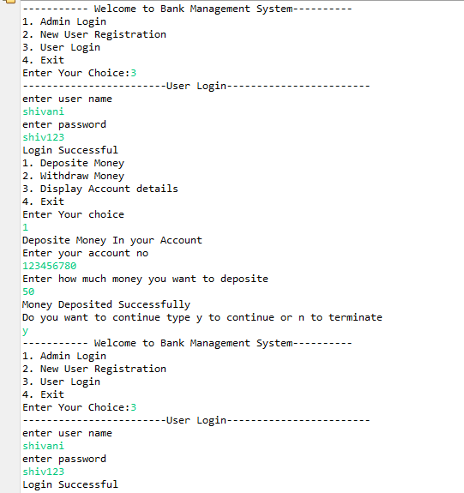
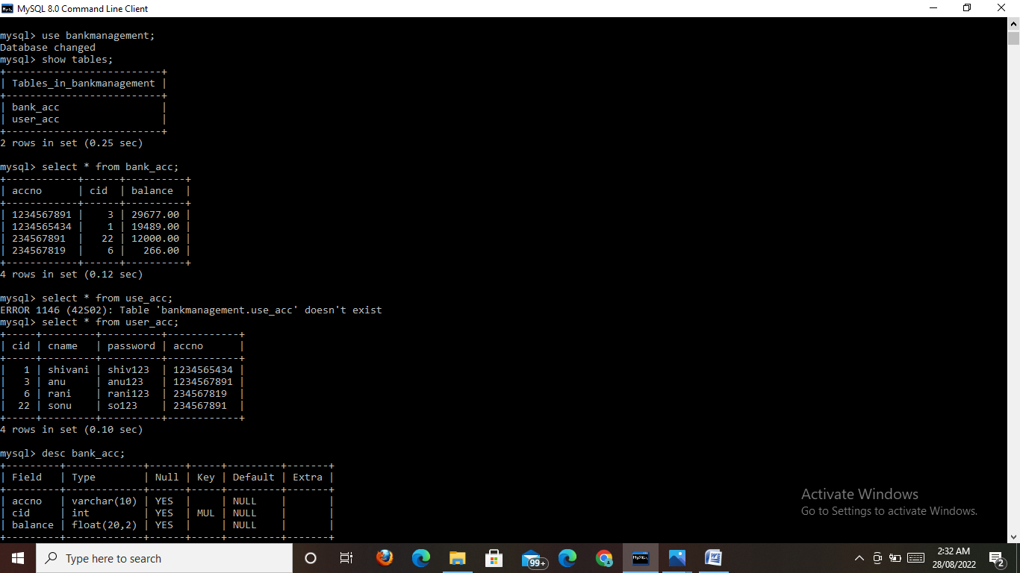
Output/Snapshot:

Slide 13
CONCLUSION:
Bank management system is a virtualization of transactions in banking system. The banking system are used manual working but when we used online banking system it is totally virtualization process which avoid manual process and converts it in automatic process .
In Conclusion, banking holds a crucial role in our day-to-day life. We must adhere to the banking system as responsible citizens. The banking system acts as a crucial base for the financial system as well as the entire economic system of the country. It provides a base to the market and the companies.

